Slide 1
Alternates to Power BI Dashboards with MS Fabric Items
Hariharan Rajendran - Microsoft MVP

Slide 2





About Me
Microsoft MVP in Power BI & MS Fabric
MCT & CompTIA Classroom Trainer
Expertise in Data and Analytics
YouTube – Hari’s BI
LinkedIn – imhariharanr
Twitter - @imhariharanr
Hariharan Rajendran

Slide 3
Agenda
Microsoft Fabric Overview
Power BI Dashboard Use Cases
Fabric Features

Slide 4
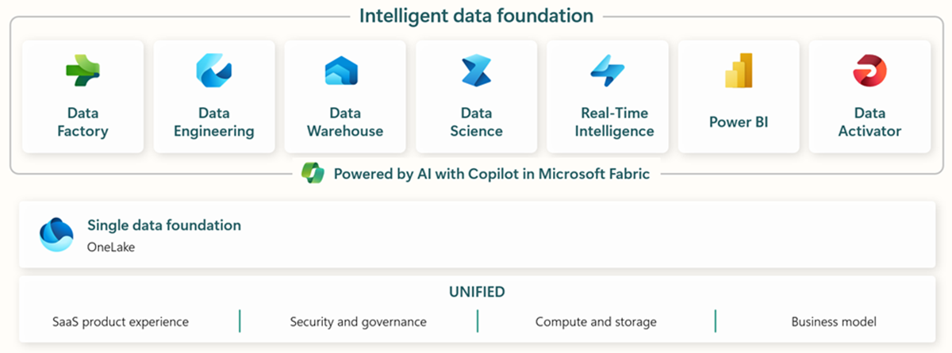
Microsoft Fabric Overview

Slide 5
Dashboard Use Cases
Power BI Dashboards are useful in specific consumption-focused scenarios where you need high-level, real-time, or cross-report insights
Combine KPIs/Visuals across reports
Embed Videos / HTML applications
Data Alerts & Notifications
Embedding in Portals / Power Apps/ TVs
Real-time Monitoring with Streaming Datasets
Mobile Consumption
Landing Page for Power BI Apps

Slide 6


Data Alerts & Notifications
Scenario:
Build an alerting system on top of Power BI data points and insights
Alerts in Dashboard Tile
Out of the box Features
Always at one metric / card level
Customization – More data points, emails and etc
No Customization
Power Automate Integration
Power Automate / Other tool dependency
Integration with other workloads

Slide 7
Demo

Slide 8
Real-time Monitoring & Dashboard
Scenario:
Real-time reports from streaming data
Streaming Dataset
Dedicated Engine for RTI
APIs, Azure Stream & PubNub
Lot of possibilities
Azure & External Services
Integrated Services
Limited Customization
Real-time Dashboards / Power BI

Slide 9
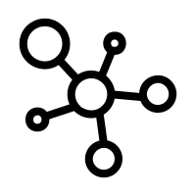


RTI in Fabric
Direct Connectors
to Streaming Sources – Apache Kafka, Azure Events, Azure IoT, Azure Service Bus etc.
Fabric Events
Subscribe to Job, OneLake and Workspace Item events
Integrated Services
Real-time dashboards, Copilot, Activator for alerts and notifications

Slide 10
Demo

Slide 11
Thank You YouTube – Hari’s BI LinkedIn – imhariharanr

